Slide 1





NodeSig: Binary Node Embeddings via Random Walk Diffusion
The 2022 IEEE/ACM International Conference on Advances in Social Networks Analysis and Mining
Abdulkadir Çelikkanat Technical University of Denmark DTU Compute abce@dtu.dk
Fragkiskos D. Malliaros Université Paris-Saclay CentraleSupélec, INRIA fragkiskos.malliaros@centralesupelec.fr
Apostolos N. Papadopoulos Aristotle University of Thessaloniki Department of Informatics papadopo@csd.auth.gr
Project website: https://abdcelikkanat.github.io/projects/nodesig/

Slide 2
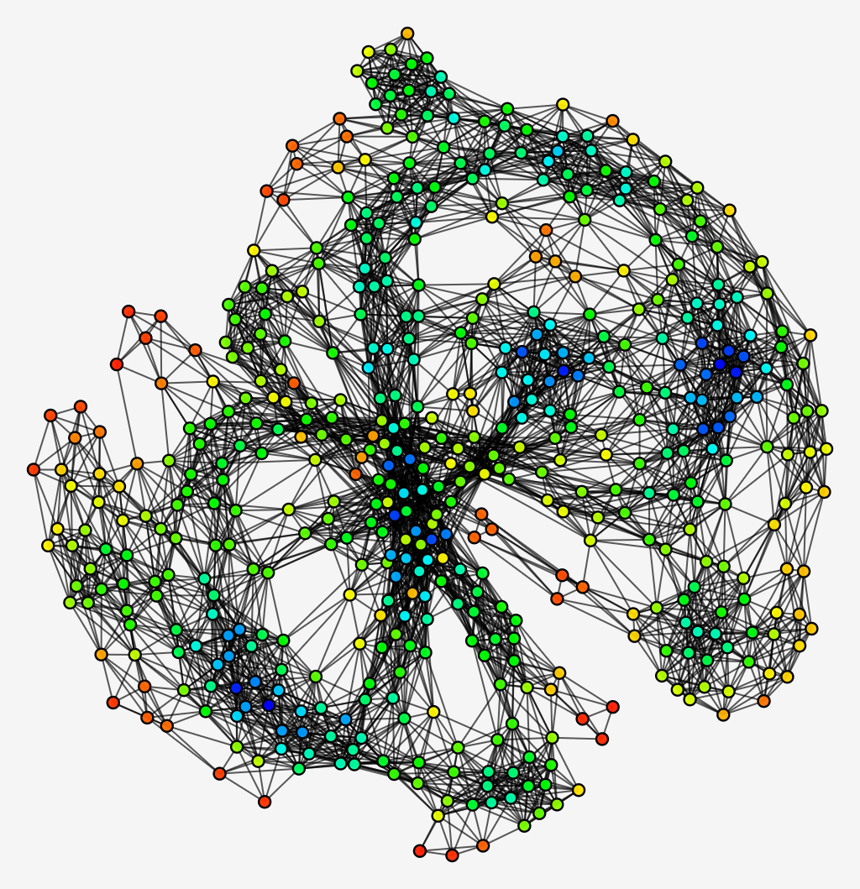
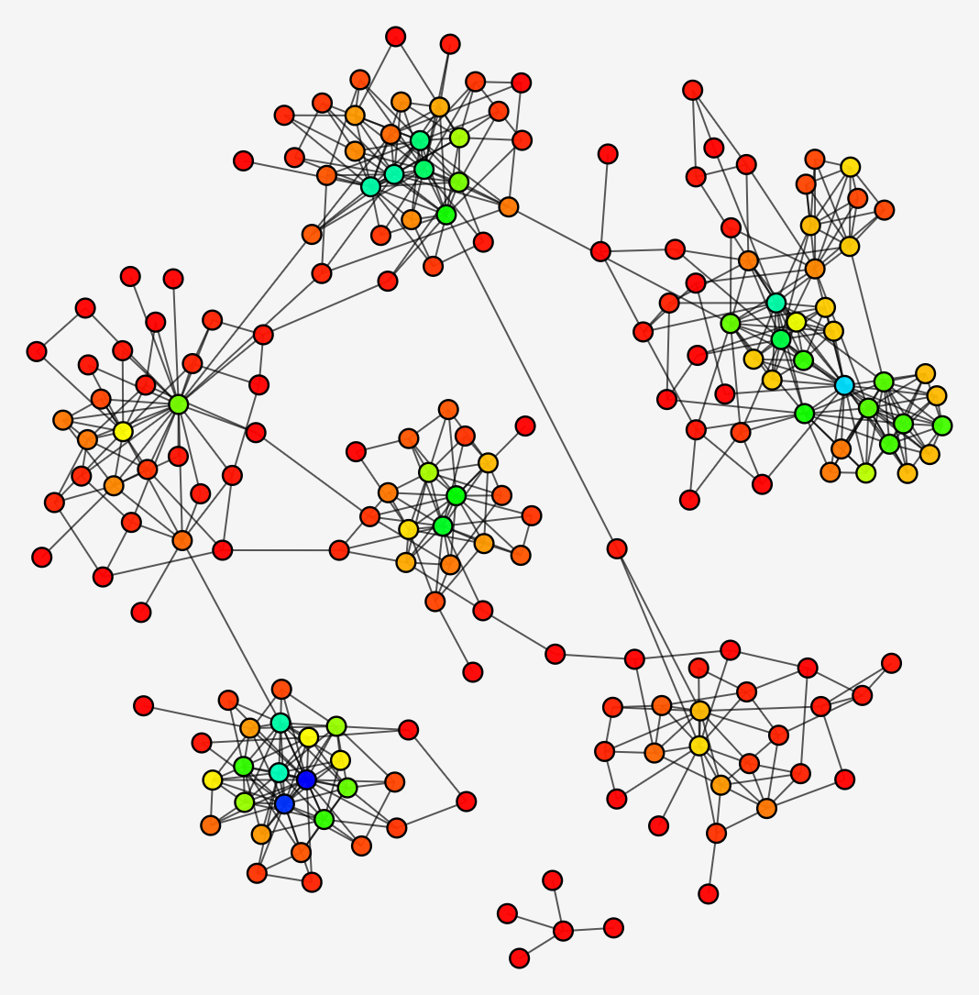
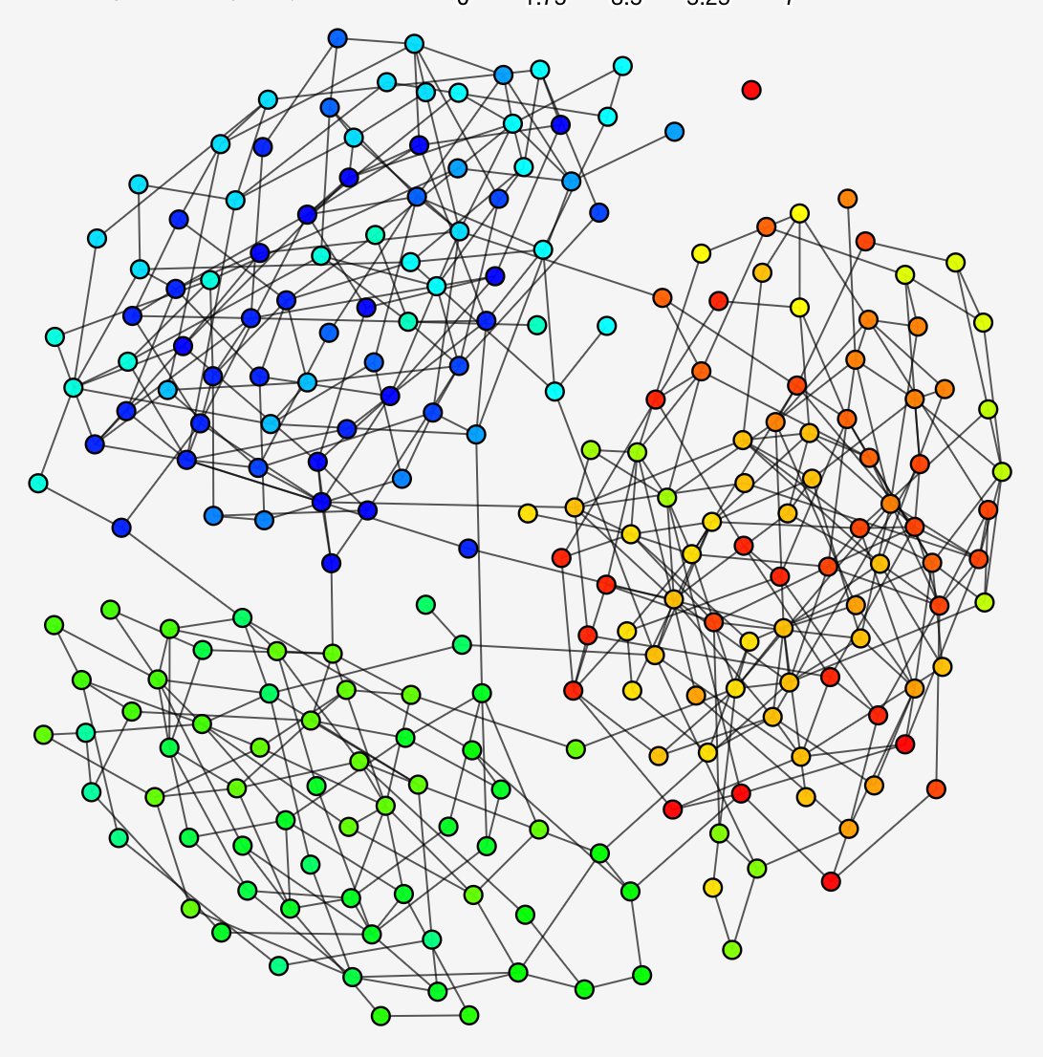
Graphs are everywhere
Graphs are everywhere
Protein-protein interaction networks
Friendship networks
Collaboration networks
Protein-protein interaction network
Friendship network
Collaboration network
[Rossi et al. AAAI ‘15]

Slide 3
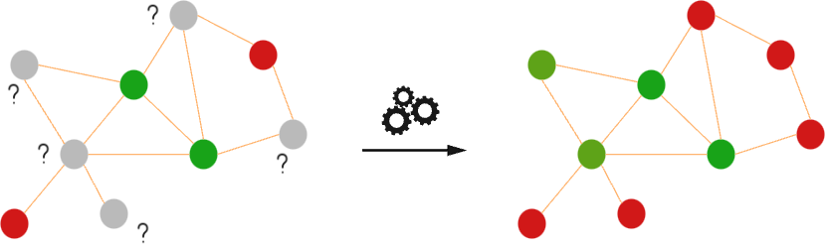
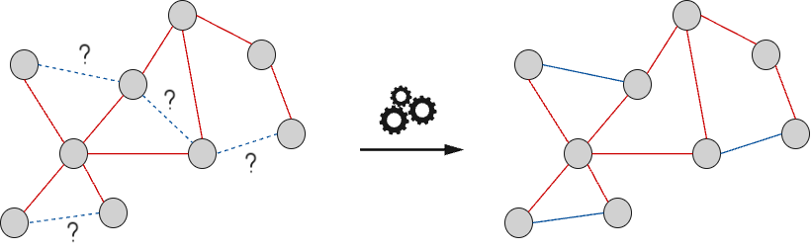
Traditional machine learning techniques on graphs
Network analysis tasks
Node classification
Link prediction
Recommender systems (AirBnb, UberEats, Pinterest etc.)
Clustering
Other tasks:
Drug discovery, traffic prediction etc.
Traditional techniques require hand-crafted features
Careful design of feature vectors concerning the task of interest
Features are limited to the specific downstream tasks and networks
Requires extensive computational cost

Slide 4
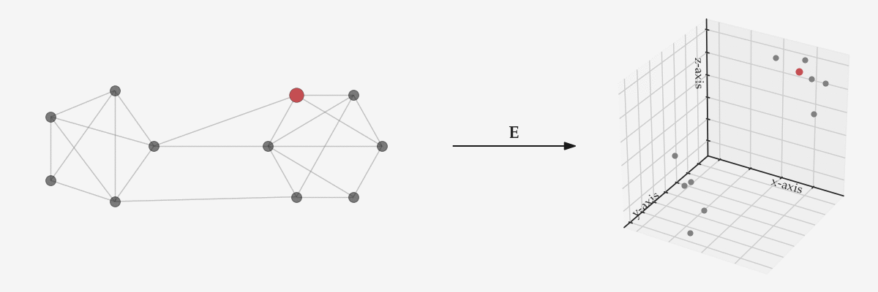
Graph Representation Learning

Slide 5
Graph Representation Learning
[Hamilton, ’20]
Error/Loss function
Correct pairwise proximities
Metric of the embedding space
Node representations

Slide 6
An algorithm balancing scalability and efficiency
How to develop an algorithm balancing scalability and efficiency on downstream tasks?

Slide 7
Motivation
Input Network
Node Representations
Locality Sensitive Hashing (LSH)
Hash Codes
Represent nodes having similar characteristics with similar representations
Mapping similar input items to the same hash code with higher probability than dissimilar ones
Smaller storage requirements
Binary, integer, real-valued
Fast computation of hash codes
Large-scale networks
Studied in other areas
Computer vision
NLP
Statistics
Fast similarity computation

Slide 8
NodeSig: Warm-up
Input network
Design of feature vectors corresponding to nodes
Choosing an appropriate hashing technique
Learning binary embeddings
[1, 0, 1, 1, 1, 0, 0, 0, 1]
[1, 0, 1, 1, 1, 0, 0, 0, 1]

Slide 9
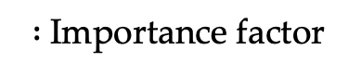
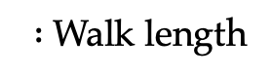
Designing node feature vectors
$:$Walk length
$:$Importance factor

Slide 10
Designing node feature vectors
$:$Walk length
$:$Importance factor

Slide 11
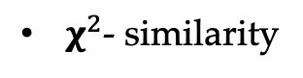
Choosing a hash function
$χ^{2}$- similarity

Slide 12
Sign stable random projections
Hash function
For a given pair of vectors , and for
$α$-stable random projections
[Li et al. NIPS ’13]

Slide 13
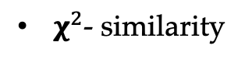
Binary representations
Approximation to $χ^{2}$- similarity by Hamming distance
[Li et al. NIPS ‘13]
Learning binary node representations
$χ^{2}$- similarity
[0, 1, 0, 0, 0, 1, 1, 0, 0, 1, 1, 0, 1, 1, 0, 1, 1]

Slide 14

Overview of the NodeSig model
: Vertex set
: Embedding size
for all and 1

Slide 15
Overview of the NodeSig model
Recursive computation

Slide 16
Overview of the NodeSig model

Slide 17
Experiments
Downstream Tasks
Node classification
Link prediction
Notes:
-We evaluate the performance of our algorithm in two different downstream tasks:classification and link prediction

Slide 18
Experiments: Datasets
Number of edges
Number of labels
Density
Number of nodes

Slide 19
Experiments: Baselines
Unsupervised graph representation learning methods
Traditional baselines
Node2Vec
HOPE
[Grover et al. KDD ‘16]
[Ou et al. KDD ‘16]
Scalable algorithms
NetSMF
FREDE
LouvainNE
RANDNE
NODESKETCH
[Qui et al. WWW ‘19]
[Tsitsulin et al. VLDB ‘21]
[Bhowmick et al. WSDM ‘20]
[Zhang et al. ICDM ‘18]
[Yang et al. KDD ’19]

Slide 20
Experimental setup for node classification
The goal is to predict the labels of the nodes in the test set
Splitting into training and testing sets
One-vs-rest SVM classifier with a pre-computed kernel
For the kernel matrix, Cosine or Hamming distance is applied
[Yang et al. KDD ’19]

Slide 21
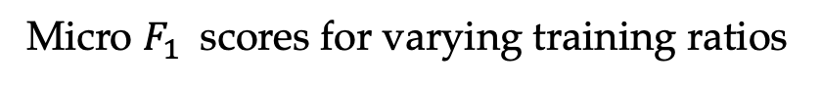
Experiments: Classification
Micro $F_{1}$ scores for varying training ratios

Slide 22
Experimental setup for link prediction
We hide half of the edges of a given network
Generate the same number of negative instances for each training and test sets
Cosine or Hamming distance is applied

Slide 23
Experiments: Link prediction
Area Under Curve (AUC) scores for the link prediction task

Slide 24
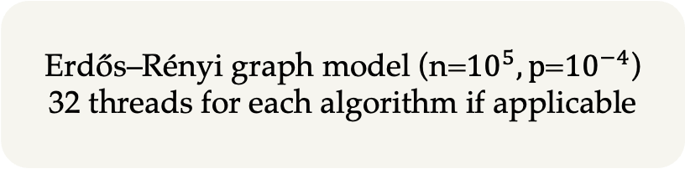
Experiments: Running time and average speedup comparison
Running time (in seconds) and average speedup
Erdős–Rényi graph model (n=${10}^{5}, p$=${10}^{−4}$)
32 threads for each algorithm if applicable
PPI

Slide 25
NodeSig: Influence of the model parameters

Slide 26
Conclusion
NodeSig: An efficient binary node embedding model
It exploits random walk diffusion probabilities via stable random projection hashing
Approximation to Chi similarity
It balances between good accuracy and low running time

Slide 27
Thank you!

Slide 28
References
[Grover et al. KDD ‘16] Aditya Grover and Jure Leskovec. Node2Vec: Scalable Feature Learning for Networks. In KDD, 2016, pp. 855–864
[Ou et al. KDD ‘16] Mingdong Ou, Peng Cui, Jian Pei, Ziwei Zhang, and Wenwu Zhu. Asymmetric Transitivity Preserving Graph Embedding. In KDD, 2016, pp. 1105–1114
[Tsitsulin et al. VLDB ‘21] A. Tsitsulin, M. Munkhoeva, D. Mottin, P. Karras, I. Oseledets, and E. M ̈uller, “FREDE: Anytime graph embeddings,” Proc. VLDB Endow., vol. 14, no. 6, p. 1102–1110, feb 2021.
[Yang et al. KDD ’19] Dingqi Yang et al. NodeSketch: Highly-Efficient Graph Embeddings via Recursive Sketching. In KDD, 2019.
[Qui et al. WWW ‘19] Jiezhong Qiu, Yuxiao Dong, Hao Ma, Jian Li, ChiWang, Kuansan Wang, and Jie Tang. NetSMF: Large-Scale Network Embedding as Sparse Matrix Factorization. In WWW, 2019
[Bhowmick et al. WSDM ‘20] Ayan Kumar Bhowmick, Koushik Meneni, Maximilien Danisch, Jean-Loup Guillaume, and Bivas Mitra. LouvainNE: Hierarchical Louvain Method for High Quality and Scalable Network Embedding. In WSDM, 2020, pp. 43–51

Slide 29
References
[Zhang et al. ICDM ‘18] Z. Zhang, P. Cui, H. Li, X. Wang, and W. Zhu. Billion-Scale Network Embedding with Iterative Random Projection. In ICDM, 2018, pp. 787–796
[Li et al. NIPS ’13] Ping Li et al. Sign Cauchy Projections and Chi-Square Kernel. In NIPS, 2013
[Hamilton ’20] William L. Hamilton. Graph Representation Learning. Morgan and Claypool Publishers, 2020
[Blondel et al. J. Stat. Mech. ‘08] Vincent D Blondel, Jean-Loup Guillaume, Renaud Lambiotte, and Etienne Lefebvre. Fast unfolding of communities in large networks. J. Stat. Mech. 2008:10 (2008)
[Yang et al. WSDM ‘13] Jaewon Yang and Jure Leskovec. Overlapping Community Detection at Scale: A Nonnegative Matrix Factorization Approach. In WSDM, 2013, pp. 587–596
[Steinwart ‘02] Ingo Steinwart. On the Influence of the Kernel on the Consistency of Support Vector Machines. J. Mach. Learn. Res. 2 (2002), pp. 67–93
[Rossi et al. AAAI ‘15] Ryan A. Rossi and Nesreen K. Ahmed. The Network Data Repository with Interactive Graph Analytics and Visualization. In AAAI, 2015

Slide 30
Appendix

Slide 31
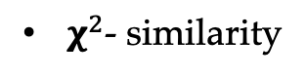
NodeSig: Experiments
Chi similarity: =
$χ^{2}$- similarity

